Slide 1

Odoo Implementation for a Computer Repair Company
Prepared by:1-Mohamed Mohey
3- Omar OSAMA 5- salah Khaled
7- Abdelrhman Radi
2- Mahmoud Mohamed
4- Amal farag
6- Israa Kabary
8- Mohamed hamed
Supervisor Name: Dr. Elwy Rady

Slide 2

Table of contents
Project Introduction
Project Overview
Problem Statement
Project Objectives
Odoo's Role
Challenges and Solutions
Project Results
Future Work
Conclusion

Slide 3

Project Introduction
The aim of the project is to implement the Odoo ERP system in a computer repair company to improve the management of daily operations such as receiving service requests, tracking repairs, and managing inventory. Odoo helps in enhancing operational efficiency and increasing transparency in processes

Slide 4

Project Overview
This project focuses on designing and implementing an integrated maintenance management system using Odoo. The system will enhance customer experience and optimize time and resource management within the company."

Slide 5
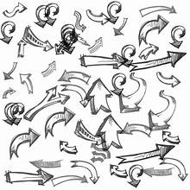
Problem Statement
"Traditional repair companies often face challenges in efficiently tracking repair requests and managing inventory. Relying on manual systems results in slower operations and increased errors, negatively impacting customer satisfaction."

Slide 6

Project Objectives
Improve the management of repair requests using the integrated Odoo system.
Streamline the tracking of devices throughout the repair process.
Enhance inventory management by minimizing errors and ensuring the availability of spare parts.
Provide accurate reports on company performance and repair teams.

Slide 7
Odoo's Role
Order Management: Odoo allows for automated logging of repair requests and tracking their progress until completion.
Inventory Management: The system ensures that necessary parts are accurately tracked and stockouts are avoided.
Reporting and Analysis: Odoo provides detailed reports that monitor team performance and improve productivity.

Slide 8
Challenges and Solutions
Challenges Faced:
Integrating operations with the new system.
Training staff to use the Odoo system.
Solutions:
Comprehensive training sessions for the team on how to use Odoo.
Customizing the system to fit the company’s specific needs.

Slide 9

Project Results
Increased operational efficiency by 40%.
Reduced errors in inventory management.
Improved customer satisfaction by reducing repair turnaround times.

Slide 10
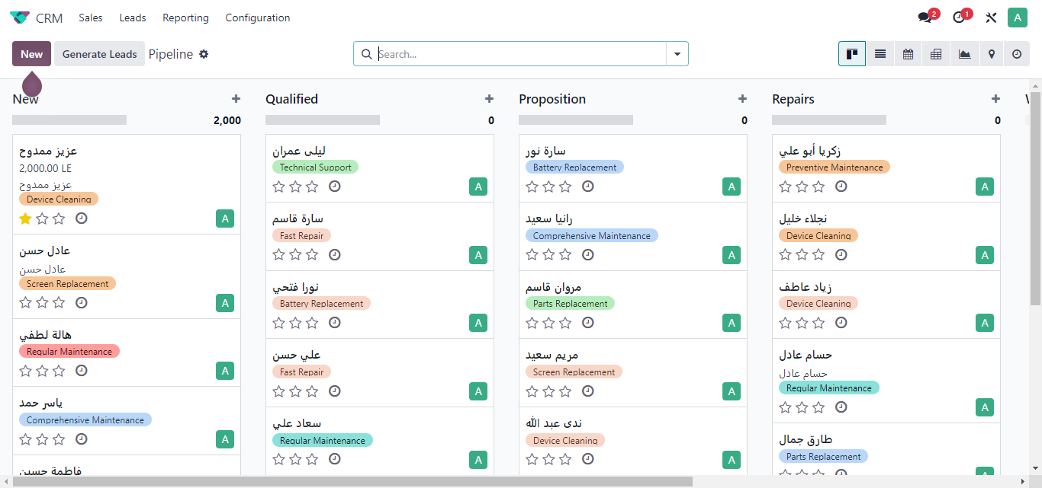
crm

Slide 11
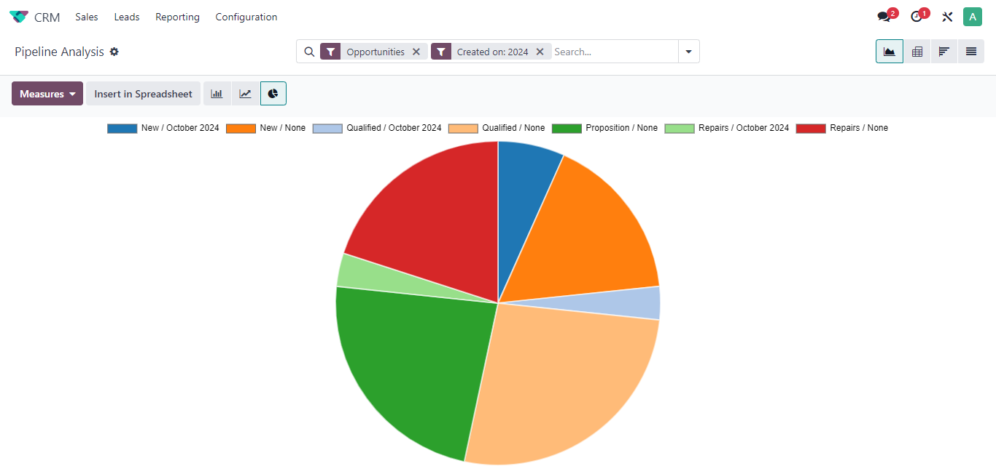
Crm Reporting

Slide 12
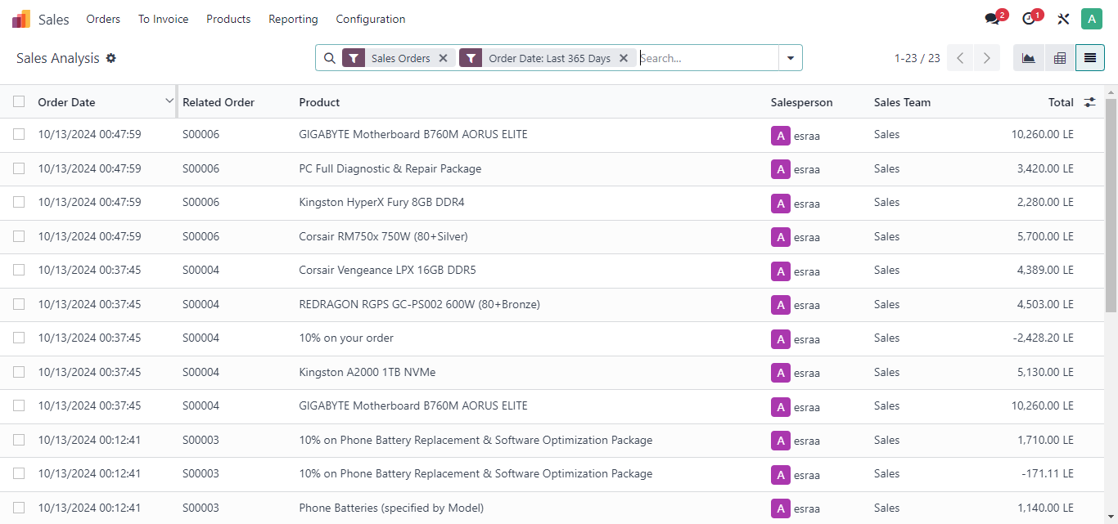
Sales

Slide 13
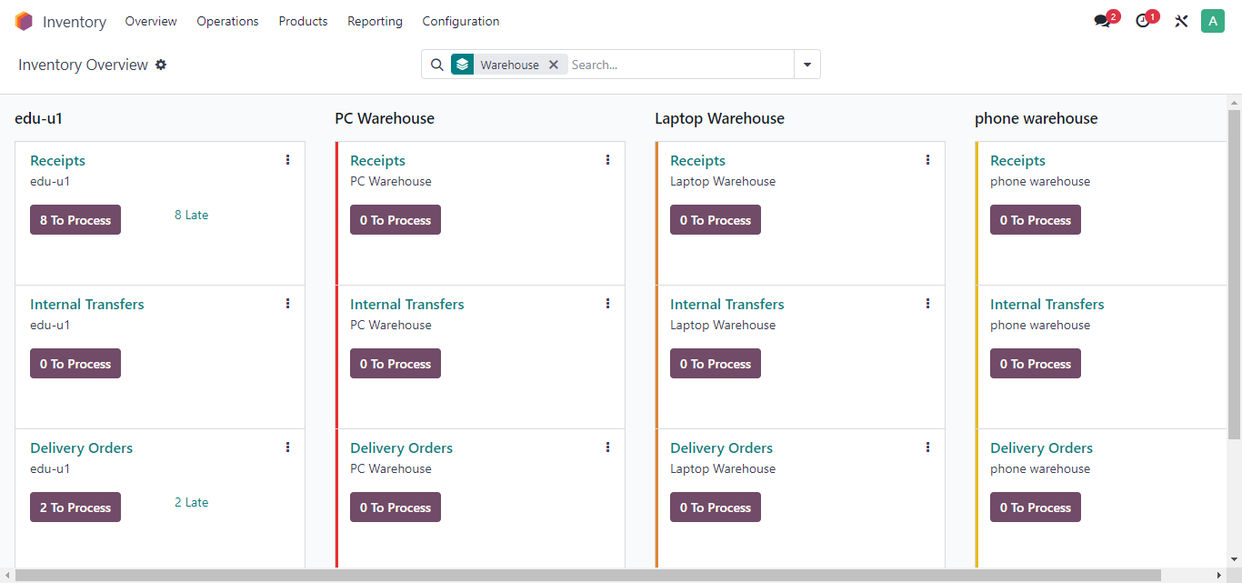
Inventory

Slide 14
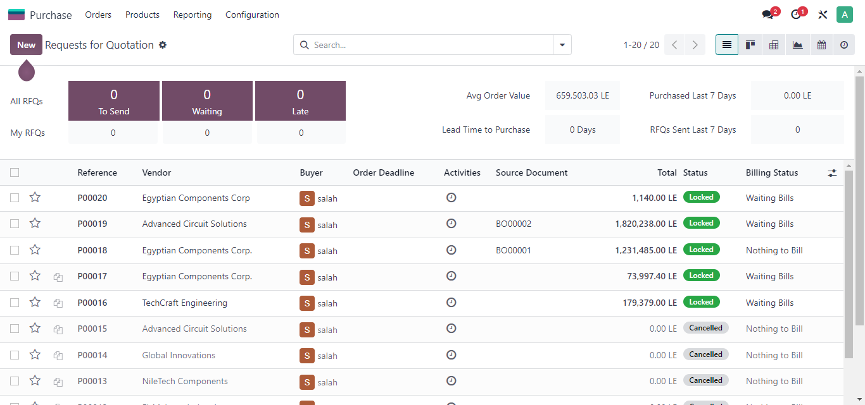
purchase

Slide 15
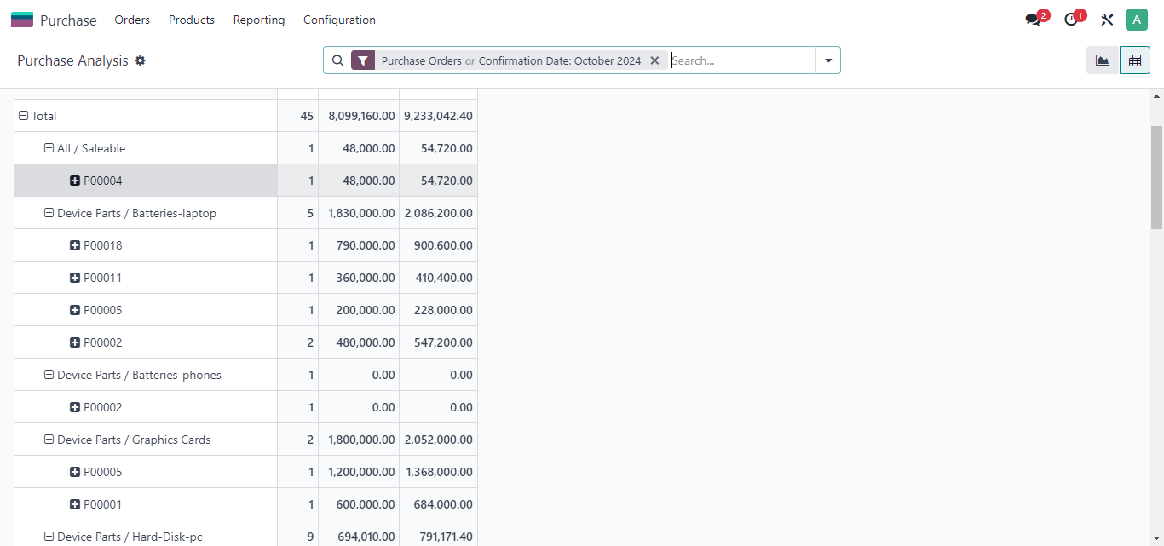
Purchase REPoRTING

Slide 16
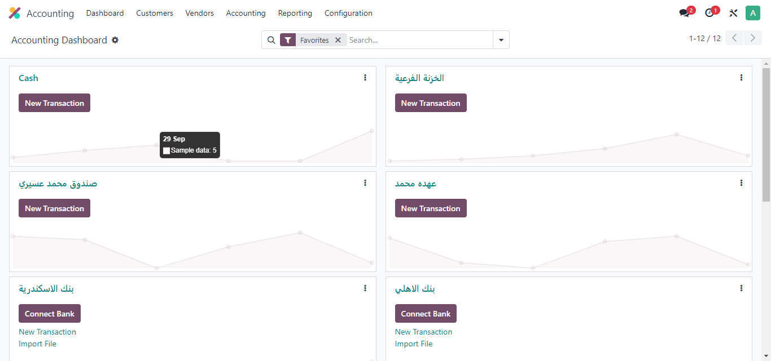
Accounting

Slide 17
Future Work
Adding new features such as online customer support.
Enhancing integration with accounting systems to manage invoicing more efficiently.

Slide 18
Conclusion
We successfully implemented Odoo to optimize the operations of the computer repair company. The system is user-friendly and effective, helping to enhance customer satisfaction and achieve significant performance improvements."

Slide 19
THE END

